Slide 1
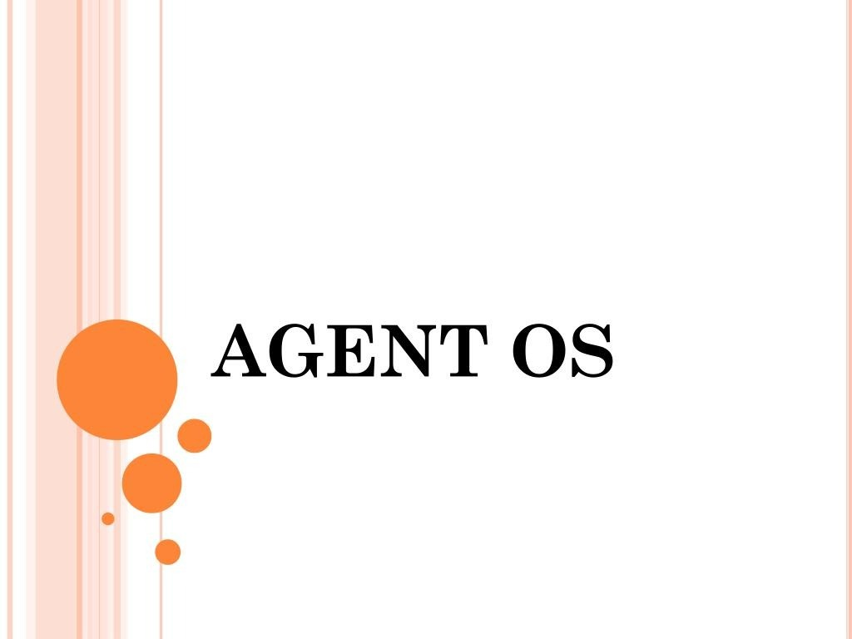

Slide 2

CONTENTS
IN’I’RODUCTION
AGENT OS
AGENTS
AGENT PARADIGM LIFECYCLE OF AN AGENT AGENT OS REQUIREMENTS DESIGN OF AGENT OS ADVANTAGES CONCLUSION
REFERENCES

Slide 3
INTRODUCTION
Internet - world wide information repository
Resource sharing on a world wide basis
Agents are new approach to the development of distributed client-server application

Slide 4
AGENT OS
Supports agent-based client-server applications
Behaves as a traditional server for a single host
Entire network-provides an environment for distributed applications

Slide 5

AGENTS
Object representation of distributed systems
Contains both computational logic and state Information
It can be a single algorithm or a complete
application
Agents are active and mobile

Slide 6
AGENT PARADIGM
Classical architecture involves two parts:
Lower Level layer-
Implementing communication protocol
Higher Level layer-
Implementing algorithm
Drawbacks
The complexity of the lower layer
Separation between these layers may not be clear

Slide 7
AGENT PARADIGM(CONTD..)
Provide solution to above problems
Distributed application is broken down into components —Agents
Agents are then used to carry out the algorithms
Agents behaves more like a centralized application
AgentOS is responsible
transporting agents
communication between agent hosts

Slide 8
AGENT PARADIGM(CONTD..)
Separation b/w communication protocol layer & application layer
Changes in applications are localised to the application layer
Changes in communication protocol do not have an effect on application

Slide 9

APPLICATION ACTIVITIES SUITED TO
MOBILE AGENTS
Distributed Data Collection
Monitoring
Information Delivery and ‘Push’ Negotiation
Transaction
Parallel Processing

Slide 10




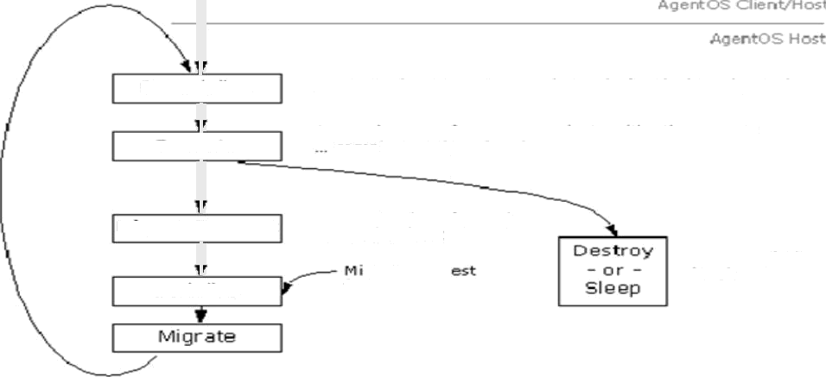
THE AGENT LIFECYCLE
C reat ion
I rnit ia I ins tanti aticen , I D q ene radio n, Age at sp ectf t c cost ¢*rnizati
S er ia li ze
S awe the agent state that is to b e migrated
/*l iqrate the o qeW and its sta te to another locatic›n
D eser iali ze
Ftocreote the agent state as it w as b clog be nq rr›iqlrated
Access host ser vices , c nicate with oth er agen ts
co mp IM e as s g n eng tas k.
E x ecu te
gr a teR equ es t
R eque st I o W mi q rated
to an ot her host
q rate requ
fr om source
Upo n comg•1ctiori
of t ask
S eria li ze
Figure 1 : Tbs e A gent Li£ec ycl e

Slide 11
AGENT OS REQUIREMENTS
Platform independence
Dynamic agent invocation
Migration of agents and their state
Inter-agent communication

Slide 12
AGENT OS REQUIREMENTS(CONTD..)
Agent reuse
Unique naming scheme
Security
Feature-rich

Slide 13
DESIGN OF AGENT OS

Slide 14
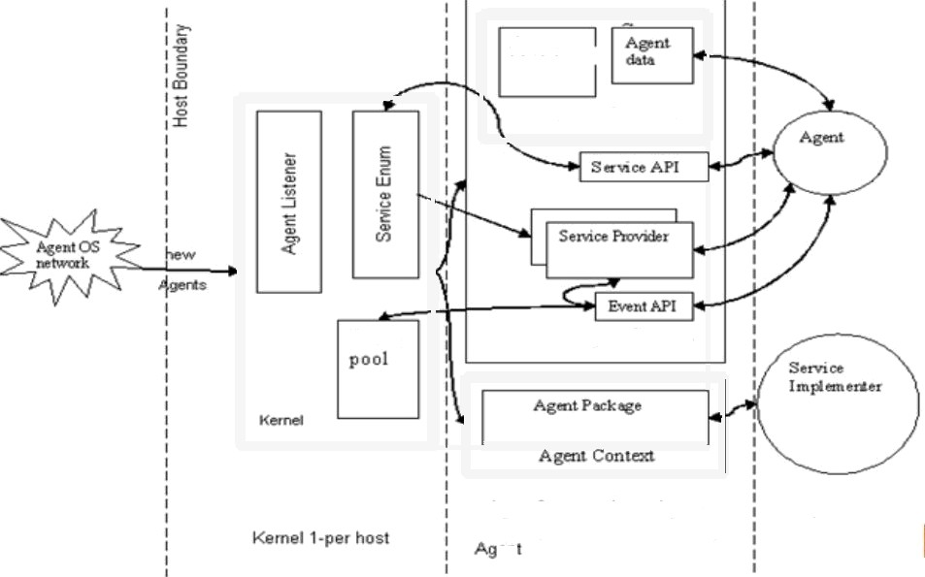

ÑYSiTEM fONfPONENTSi
Module
AgmtPaclœgc
Event
Agent Conie›a
AgentContext -1 per Agent
Senric e provider 1•per servir e per
en
Agents
Figure 2 Structural O«er¥j6w of the Ager‹tOS Architect ura

Slide 15

SYSTEM LIOMPONENTS(CONTD..)
Kernel
Provides access to system services Monitoring n/w connection Implement communication protocol
Service Enum
Part of kernel subsystem
Manages a list of standard and extended services

Slide 16
SYSTEM COMPONENTS(CONTD..)
Event Pool
Each AgentOS s/m contains a single event pool Provides queue based communication b/w agents
Agent Context
Provides execution model for agents
Starts, stops and controls the execution of agents

Slide 17
Agents
SvSTEM COMPONENTS(CONTD..)
Implements computational logic
AgentPackage
Used in migration of the agent
Contains agents & resources needed to execute agents
Service Providers and Service Implementers Service provider - API for agent to access services Service implementer — implements actual service

Slide 18

INSTANCE IDs
AgentOSID
Static ID
Combination of n/w address,time stamp and a sequential
counter
Guarantees uniqueness to static objects
AgentInstanceID
Guarantees uniqueness to static & active objects Combination of n/w address and time of creation

Slide 19
ADVANTAGES
Load balancing & Fault tolerance
Disconnected operation
Reduced Inter-node communication Event based communication Secure transaction

Slide 20



CONCLUSION
AgentOS is an OS “of agents, for agents, and by
agents”
System functions are carried out by agents, hence
an OS of agent
Agent OS manages the agents,hence OS for
agents
For agent communication underlying protocol is partially generated by agents

Slide 21
REFERENCES
o htt ://www.iavaworld.com/1aVawOrld/1W-04-1997/10w4 agents.html
o htt lash.iavasoft.com/beans/s ec.html
o htt ://www.1aVaworld.com/1avaworld/1W-04-1997/1W-04-
hood.html

Slide 22
ANY QUESTIONS???

Slide 23
THANK YOU...

